Slide 1
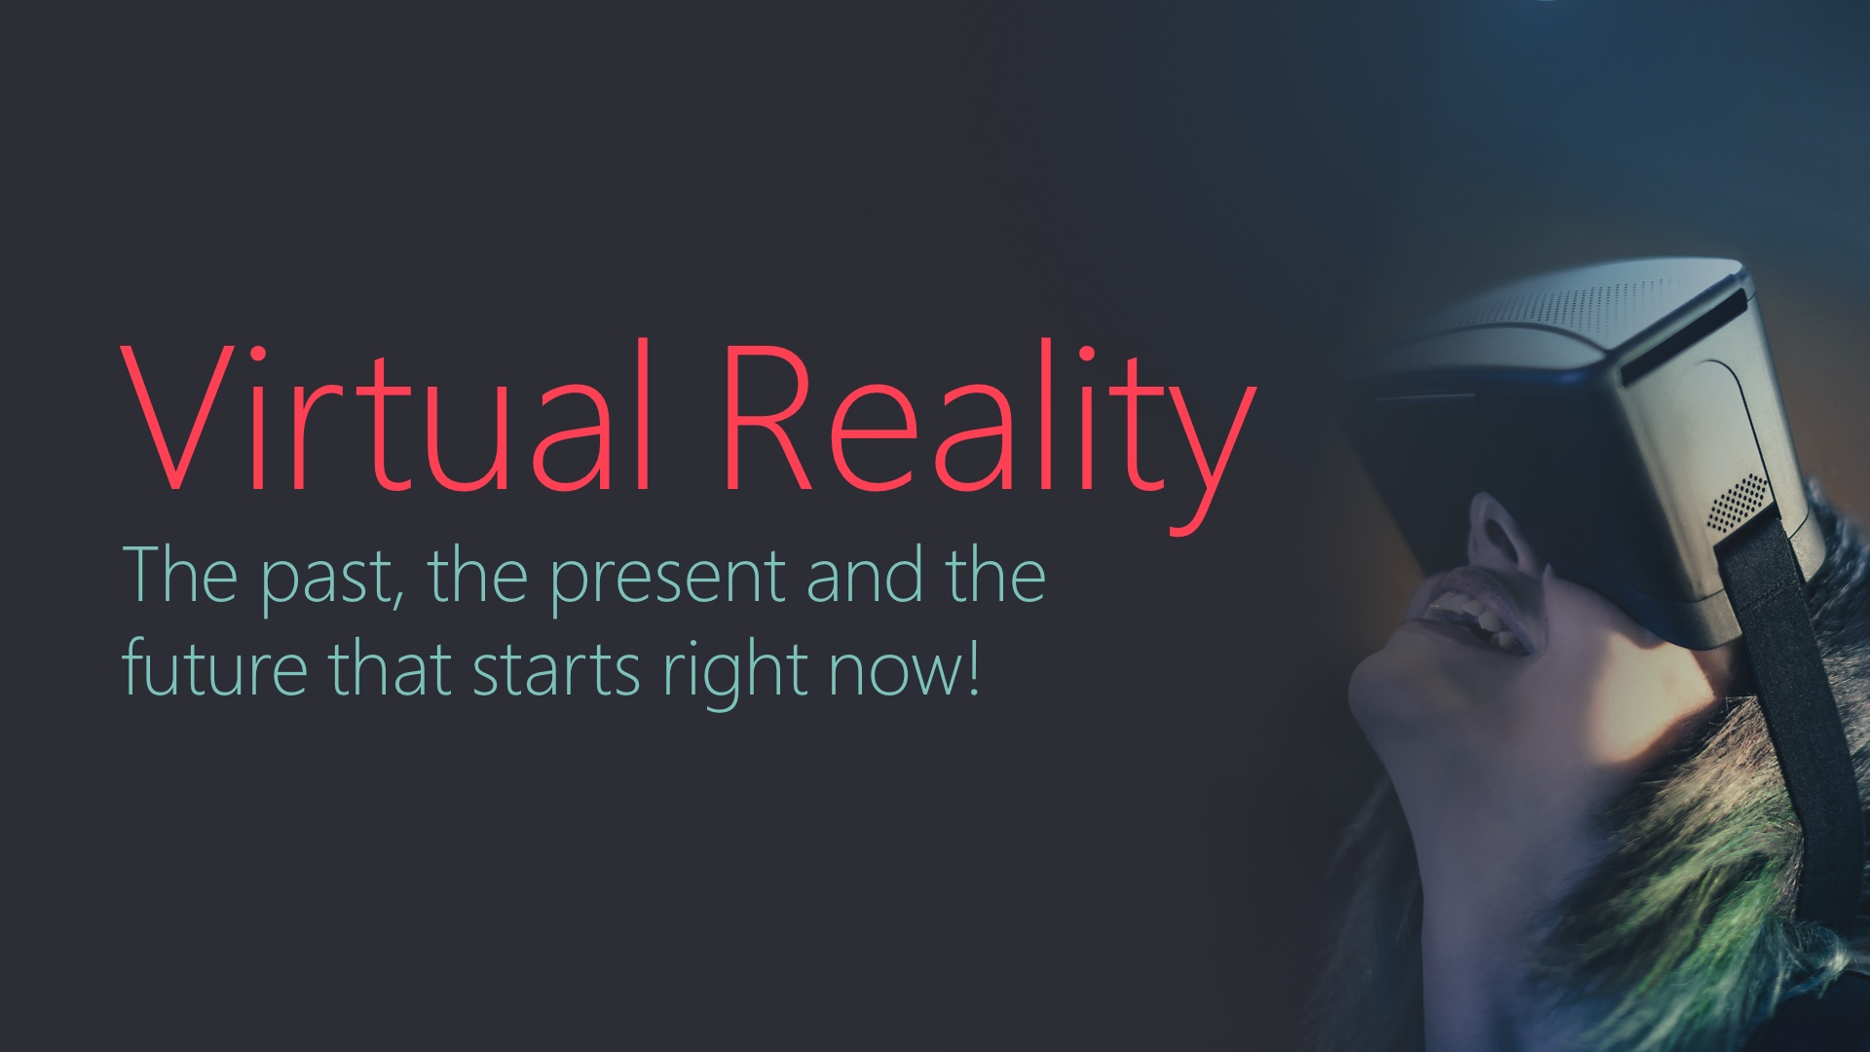
Notes:
Introduce yourself and provide a brief introduction to the Microsoft Tech Talk series.

Slide 2
Notes:
Yes, that's right, we're starting our discussion today with a story about high-speed pizza delivery.
In 1992, Neal Stephenson wrote Snow Crash, the story of Hiro Protagonist. In this futuristic society, Hiro delivers pizza for CosaNostra, a pizza empire owned by the Sicilian mafia. Every pizza comes with a 30 minute timer on the side of the box. Delivery before the clock hits 30:00 guaranteed or the driver dies!
That’s a pretty high stress job! While not working, Hiro spends his free time connecting to the metaverse a virtual world that anyone can connect to. In the real world, Hiro lives in a small storage unit, but in the metaverse he owns an expansive home with gardens. His description and ideas about this alternate reality have influenced the Internet and virtual worlds like Second Life. Today Stephenson is working at Magic Leap, a company developing augmented reality devices.
Today we’ll explore the explosion of interest in Virtual, Augmented, and Mixed reality.

Slide 3
Early Devices
1960s–2000s
Notes:
Before looking at the latest VR devices, we're going back in time to understand the history of VR

Slide 4
1962
Sensorama
Notes:
Morton Helig was a cinematographer in the 1950s and is often referred to as The Father of Virtual Reality
In 1955 he wrote a paper titled, “The Cinema of the Future”, where he described an experience that would engage all of the participants senses.
By 1962 he had built a machine called the Sensorama with stereoscopic view.
One of his early experiences was a motorcycle trip through Brooklyn.
The seat vibrated as if rumbling from the engine, wind blew across the viewer's face, and even included a city scent to enhance the experience.

Slide 5
1978
MIT Aspen
Movie Map
Notes:
The Movie Map was developed at MIT in 1978.
Early version of Streetside view maps
The team carefully drove a car around the streets of Aspen Colorado.
Pictures were taken every 10 feet and broken into city-block segments stored on Laserdisc
The device allowed users to travel any path through the city of Aspen.
While watching the video, note the touchscreen input to choose the path through the city.

Slide 6
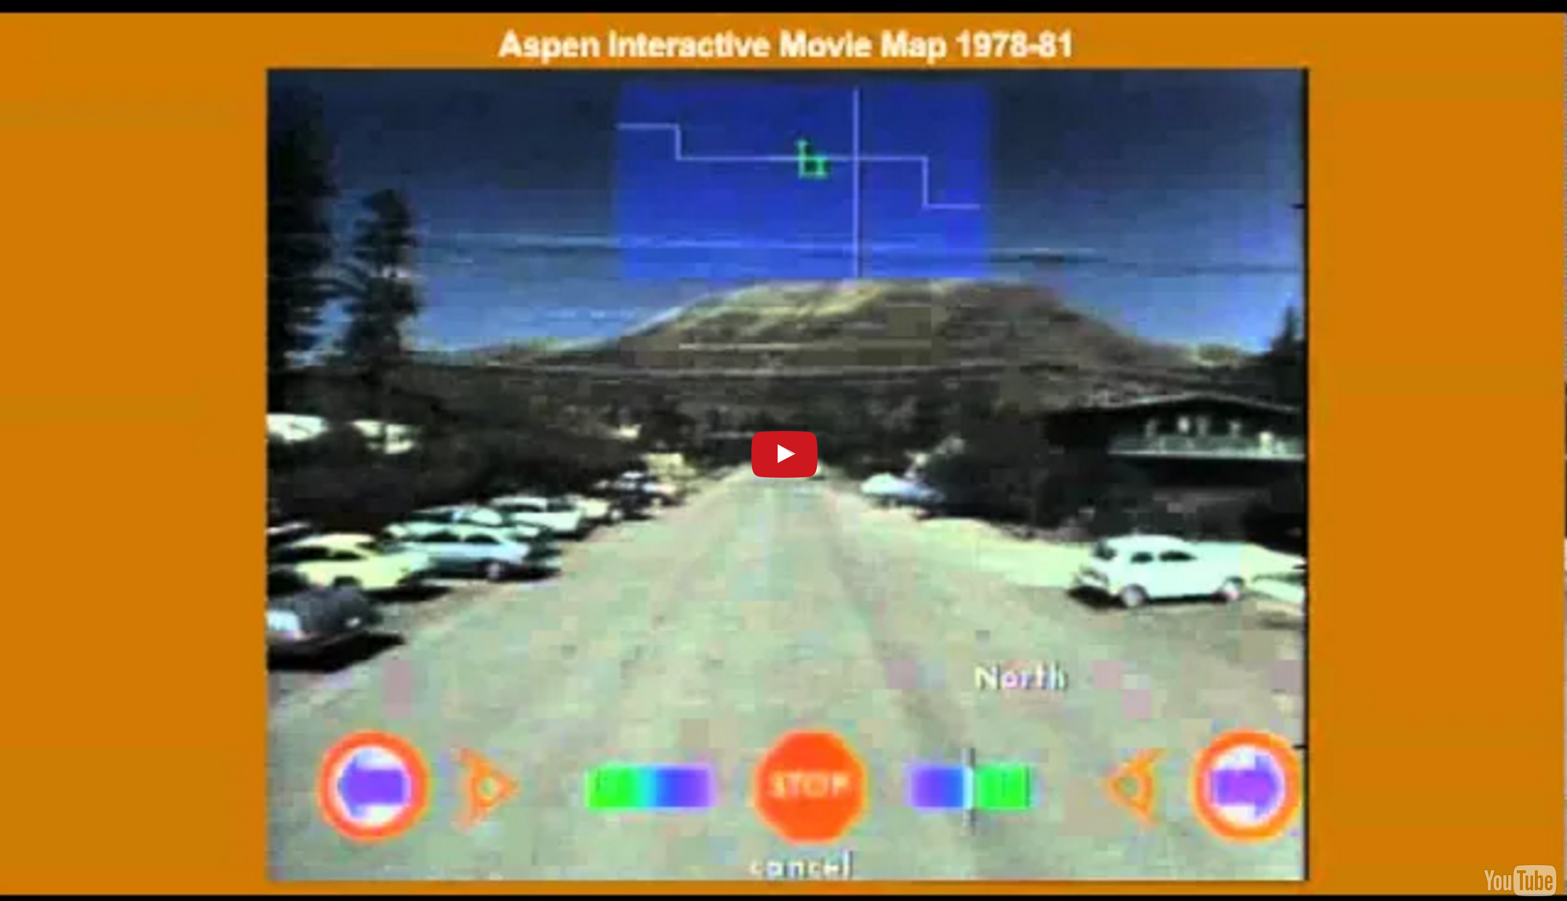
Notes:
Remember, with only red LEDs, all games were monochromatic!
A comparison point to see how far we have come in recent years

Slide 7
1985
Data Glove
Notes:
In 1984 Jaron Lanier founded a company called VPL Research.
Jason coined and popularized the term “virtual reality”
The company developed software and hardware to create virtual reality experiences.
One of their first devices was the DataGlove, an input device worn by users to interact with virtual worlds.
VPL also created the EyePhone, a head-mounted display and AudioSpehere which used stereo to create the illusion of 3D sound.
Today Jaron is an architect at Microsoft Research

Slide 8
1978
Nintendo
Virtual Boy
Notes:
In 1995 Nintendo released a 3d headset video game system
The display used red LEDs to display a 3d stereoscopic view
The system faced several challenges common to early VR systems: high price, uncomfortable while playing, and a lack of compelling software options.

Slide 9
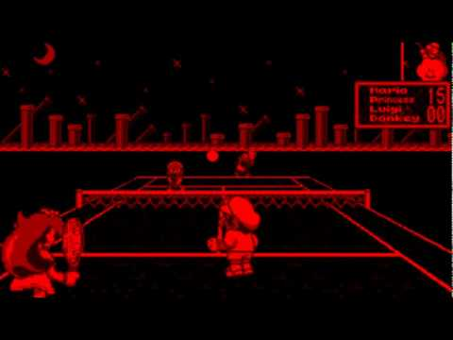
Notes:
Remember, with only red LEDs, all games were monochromatic!
A comparison point to see how far we have come in recent years

Slide 10
Modern Devices
2000s–Present
Notes:
With an understanding of past VR devices, now we'll look at some of the latest VR devices on the market today

Slide 11
Mobile
Computing
and the
Rise of VR
Notes:
Many early systems failed because technology was too expensive and bulky.
Mobile computing advances have made the VR revolution possible.
People own major component (phone) which contains fast CPU, GPU (relative to the past) and a variety of sensors.
Most consumers are on a regular 12-24 month upgrade cycle. Much faster than pc replacement cycle.
Even dedicated VR hardware has benefited from the economy of scale that the mobile computing revolution has brought.

Slide 12
VR
Provides presence in places
That would not otherwise
Be possible.
Notes:
VR = Virtual Reality
Lots of excitement in this space.
Includes synthetic environments like 3D games as well as live performances.
Example: Cirque du Soleil VR puts viewers in the middle of performances
NBA experimenting with VR court side seats for at home viewers

Slide 13
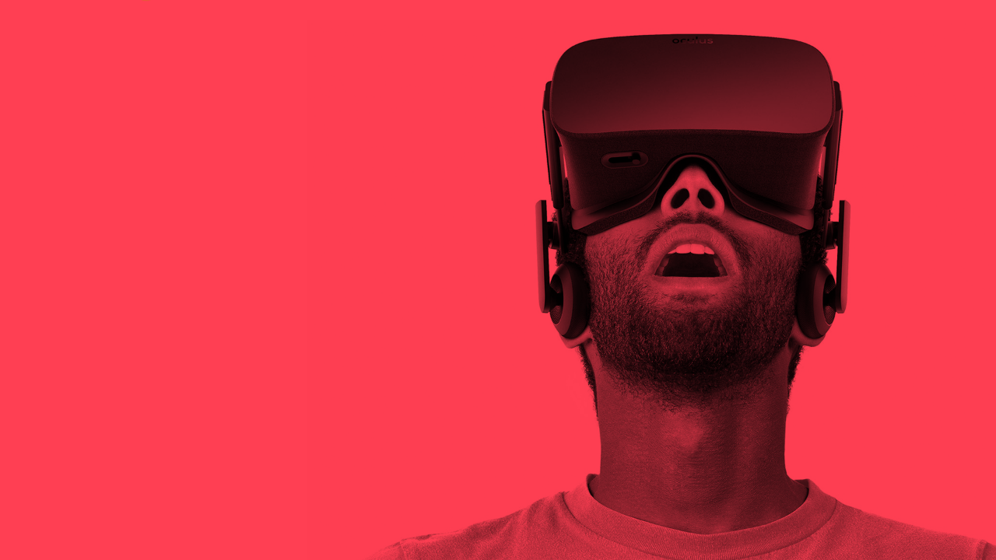
Oculus Rift
Notes:
Palmer Luckey, a teenager in Southern California, tinkered with head-mounted displays (HMD)
His designs caught the attention of John Carmack (of id Software and Doom fame)
John demoed an early Rift prototype at E3 in 2012 to serious acclaim
Oculus's subsequent Kickstarter went on to raise more than $2 million.
Less than two years later, Facebook acquired Oculus for $2 billion

Slide 14
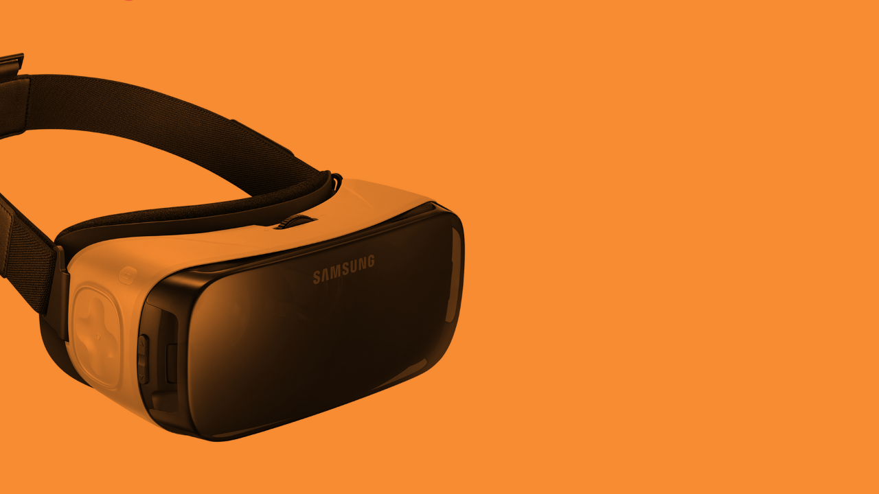
Samsung
Gear VR
Notes:
Samsung partnered with Oculus to develop the GearVR
Relatively cheap (approx $100) adapter for Samsung Galaxy phones
Uses a somewhat simplified version of the Oculus SDK
Low price and readily available hardware makes this one of the most consumer friendly entries into VR (and a good place to start development if you just want to get your feet wet)

Slide 15
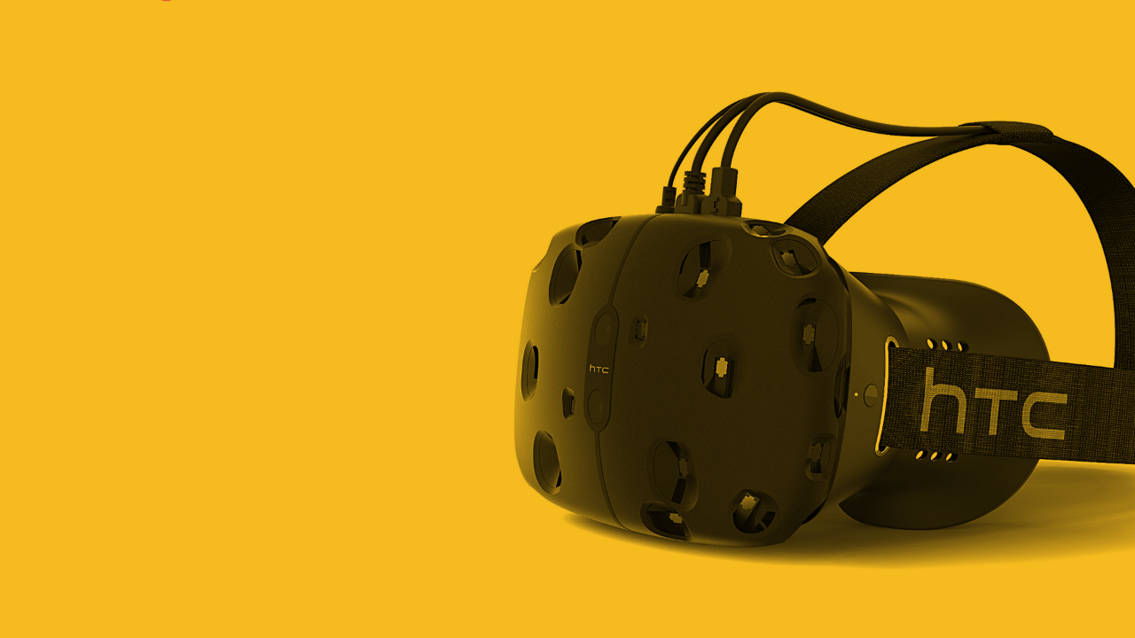
HTC Vive
Notes:
Vive offers a very high quality picture with refresh rate of 90 Hz on two screens, one per eye, each having a resolution of 1080x1200.
Headset is tethered
Vive uses two cube sensors placed in the room to augment position information
Includes two wireless handheld controls with haptic feedback

Slide 16
AR
Overlays information on top
of camera output or a
transparent view
Notes:
AR = Augmented Reality
When you hear AR, think Heads-Up Display (HUD)

Slide 17
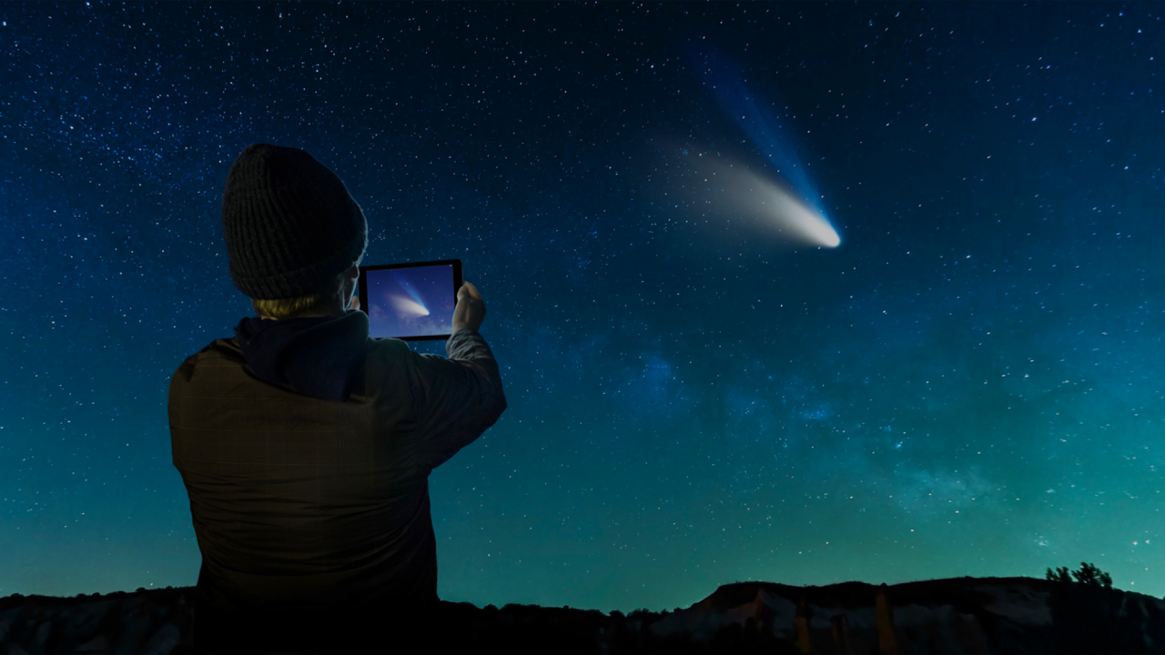
Sky Guide
Notes:
Many Augmented Reality apps
Example: Sky Guide is a mobile application that follows the orientation of a phone and overlays information about stars, planets, satellites, and other celestial objects.

Slide 18
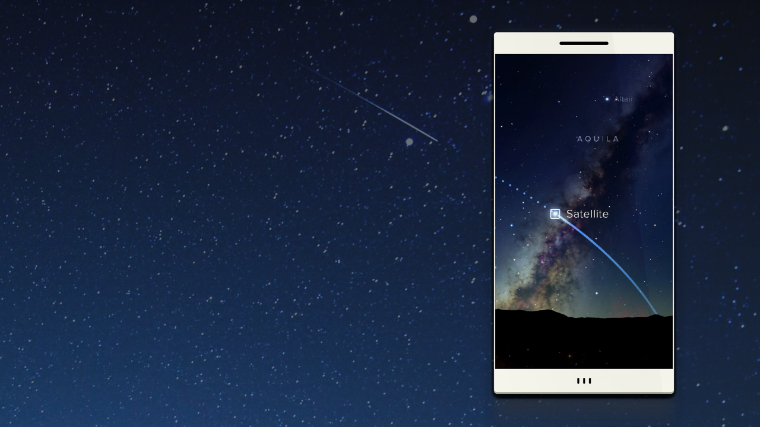
Space station orbit is
projected based on the
phone’s orientation.
Notes:
Sky Guide augments reality with information on satellites and the position of other objects that cannot be seen.

Slide 19
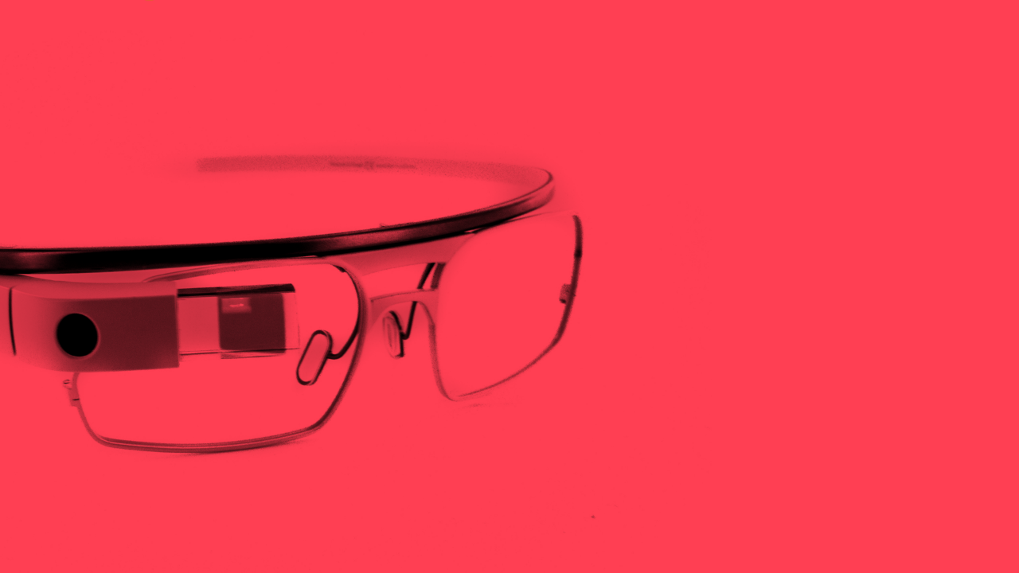
Google
Glass
Notes:
Google glass was an early attempt at AR, attaching a small display resembling a set of eyeglasses

Slide 20
MR
Seamlessly blends
physical and digital into a
single reality.
Notes:
MR = Mixed Reality
Virtual objects coexist with real objects.
Also sometimes referred to as “Hybrid Reality”

Slide 21
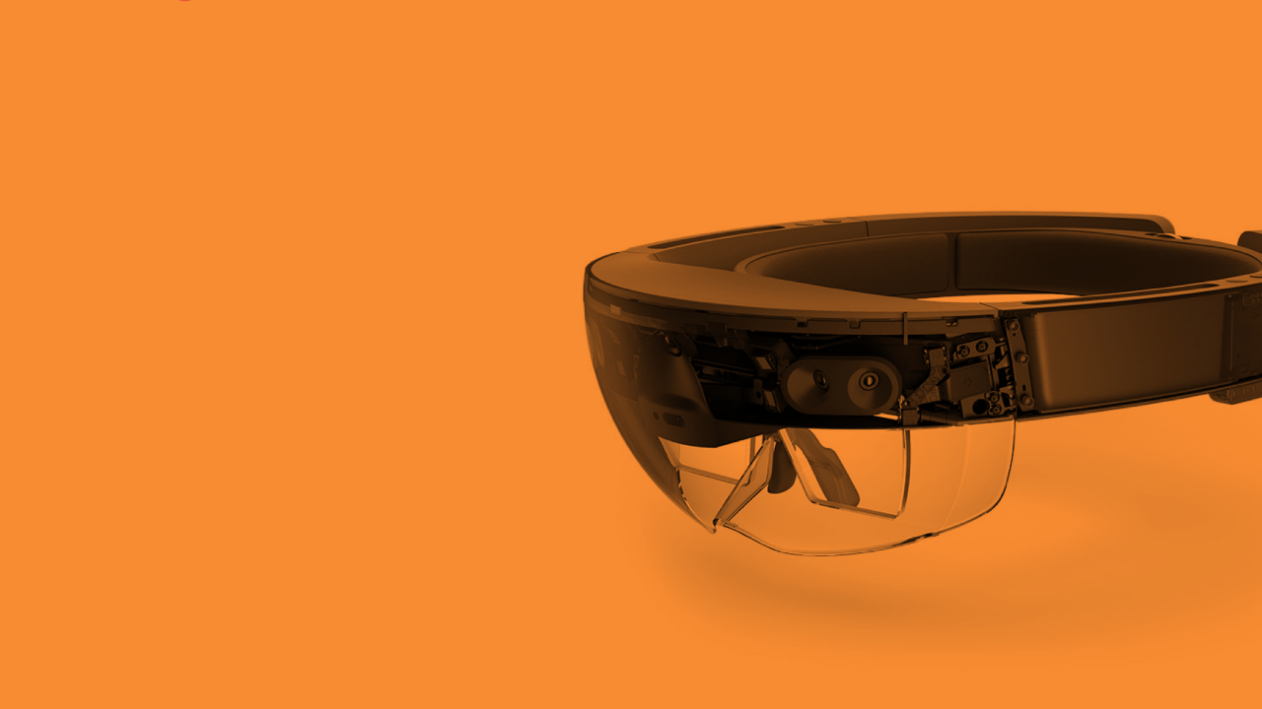
Hololens
Notes:
Device has to model reality in 3D space so it can place 3D objects realistically
Hololens requires custom processor to handle massive amounts of data needed. Called Holocoprocessor

Slide 22
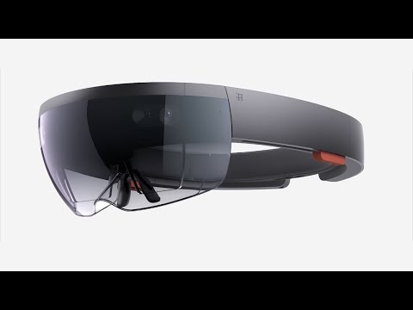
Notes:
Video overview of the technology inside Microsoft Hololens.

Slide 23
3D Basics
Notes:
All AR / VR / MR relies on 3D rendering and displays. In the next few slides, we’ll discuss some of the building blocks shared by all VR platforms.

Slide 24
Stereoscopic Imaging
Present a different image to each eye to create a sense depth from the parallax that emerges.
Notes:
There are many different ways of transforming 2d images into something that approximates human vision
We'll look at a couple different methods

Slide 25
Anaglyph 3D
Notes:
Probably the most familiar 3D glasses, they are extremely cheap to produce and the images don't require specialized hardware.

Slide 26
Notes:
An example of a composite anaglyph image generated from the stereo Pancam on Spirit, one of the Mars Exploration Rovers.
It can be viewed stereoscopically with proper red/cyan filter glasses.

Slide 27
Dual Display Headset
Notes:
Many modern VR systems split a display into two regions, one per eye. Others have 2 distinct displays.

Slide 28
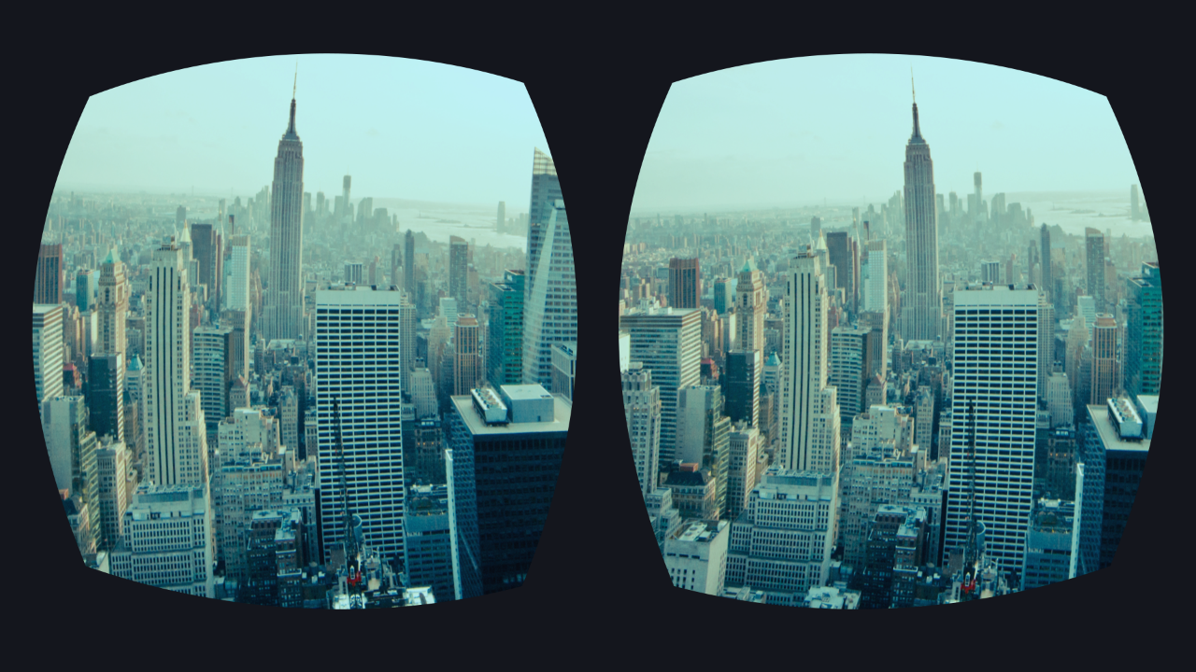

Slide 29
Let’s write some code!
Notes:
We’ll use Hololens to demonstrate a number of VR concepts. You won’t need Hololens hardware, the entire demo can be run using the Hololens emulator on your PC.

Slide 30
Tools
Notes:
While you don’t need to walk through all the setup steps, it’s helpful to provide a brief overview of the tools used for Hololens development, primarily Visual Studio and Unity.

Slide 31
Notes:
Unity is the foundation for many of the VR products currently in the marketplace. While most VR solutions have their own framework, typically this is based on top of the foundation pieces for VR and 3D that Unity provides.

Slide 32
Notes:
For Hololens, the world is set up inside of Unity but all of the actions and behavior is implemented in c#. Unity and Visual Studio have great integration, you can click an Action in Unity and it will open up the VS editor. Rebuild in VS and Unity will pick up the updated module.

Slide 33
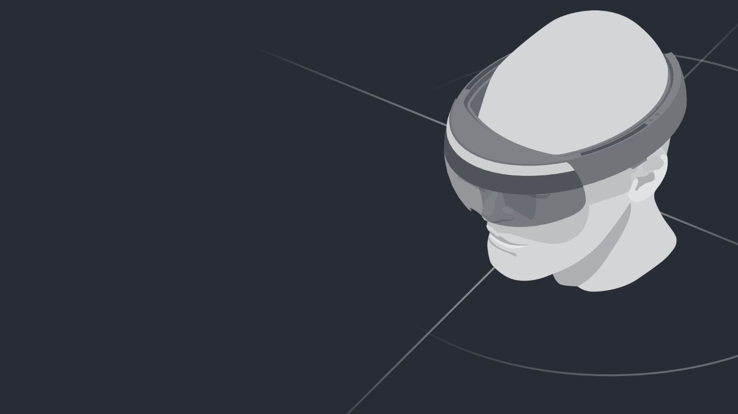
“Holo” World
Notes:
Most platforms start off with a “Hello World” application that is an example of a very basic project. The Holo World example shows a basic scene in 3D.

Slide 34
Objective
Set up Unity for holographic
development and make a hologram.
Notes:
There are instructional videos for each step of the demo, including the basic project setup.
https://developer.microsoft.com/en-us/windows/holographic/holograms_101e
Because it takes time to setup the Hololens environment and create the basic project, we recommend you do that prior to delivering the talk.

Slide 35
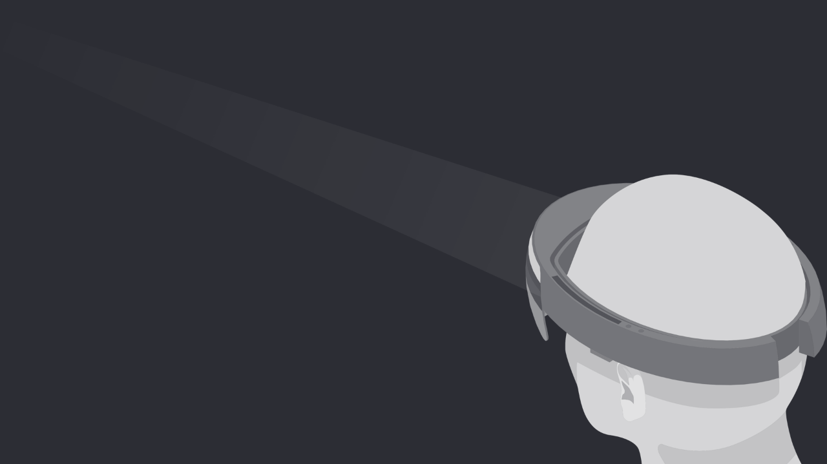
Gaze Input
Notes:
Presenter overview video for the Gaze Input section:
https://www.youtube.com/watch?v=BPWTbAC210k

Slide 36
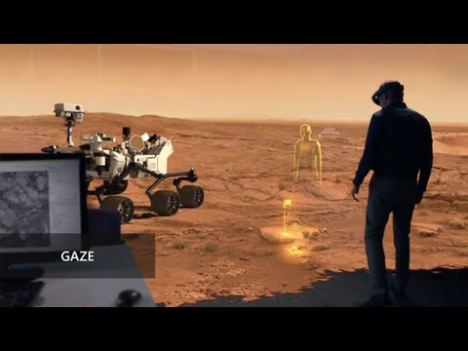
Notes:
Audience video overview of Gaze using the Hololens

Slide 37
Objective
Visualize your gaze using a world-locked cursor.
Notes:
Gaze is the first form of input and is used for targeting within holographic apps. Gaze tells you where the user is looking in the world and lets you determine their intent. In the real world, you'll typically look at an object that you intend to interact with. This is the same with gaze.
HoloLens uses the position and orientation of your user's head, not their eyes, to determine their gaze vector. You can think of this vector as a laser pointer straight ahead from directly between the user's eyes. As the user looks around the room, your application can intersect this ray, both with its own holograms and with the spatial mapping mesh to determine what virtual or real-world object your user may be looking at.
On HoloLens, interactions should generally derive their targeting from the user's gaze, rather than trying to render or interact at the hand's location directly. Once an interaction has started, relative motions of the hand may be used to control the gesture, as with the manipulation or navigation gesture.

Slide 38
Notes:
Briefly explain that the code is creating a ray that projects from the user’s head position towards the direction of their gaze. If the raycast hits an object, then it will display the mesh.

Slide 39

Gestures
Notes:
Presenter overview video of the Gestures section:
https://www.youtube.com/watch?v=6d-0RHeKHq4

Slide 40
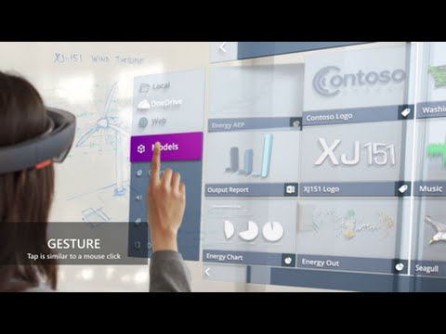
Notes:
Audience overview video of Gestures using Hololens

Slide 41
Objective
Control your holograms with the Select gesture.
Notes:
Gestures are the next of the three primary forms of input on HoloLens. Once you've targeted a hologram with gaze, gestures allow you interact with the hologram. Gesture input lets you interact with your holograms naturally using your hands or, optionally, with a clicker.

Slide 42
Notes:
Briefly explain the code. The gesture recognizer does the heavy lifting of detecting a gesture and firing events. The event simple enables physics on the selected object.

Slide 43
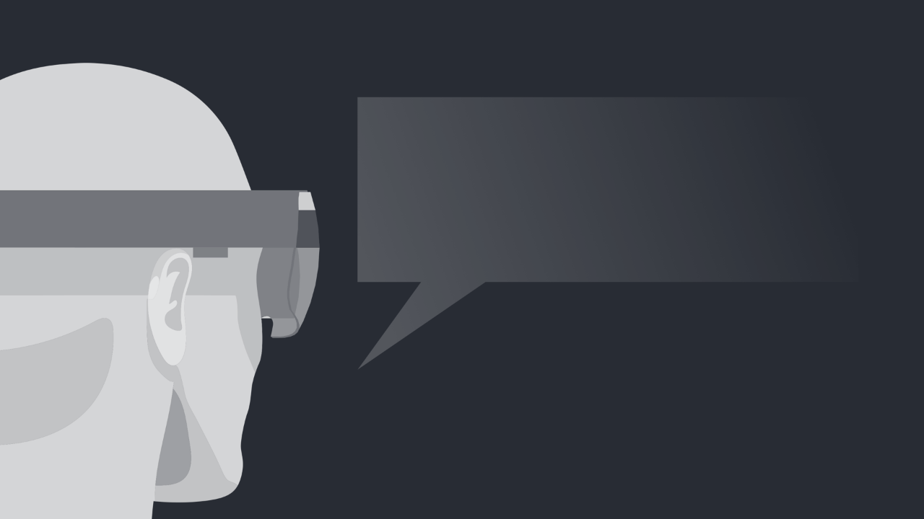
Voice
Notes:
Presenter overview video for the Voice section:
https://www.youtube.com/watch?v=LxbOhnd2_GM

Slide 44
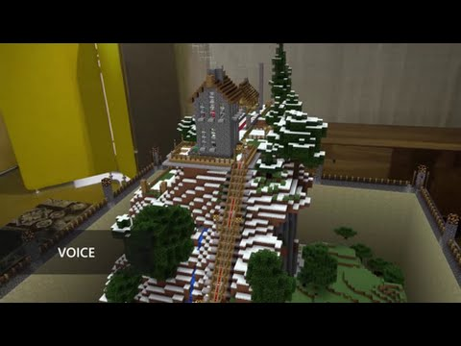
Notes:
Audience video overview of Voice in Hololens

Slide 45
Objective
Add voice commands that always listen in the background.
Notes:
Voice is one of the three key forms of input on HoloLens. It allows you to directly command a hologram without having to use gestures. You simply gaze at a hologram and speak your command. Voice input can be a natural way to communicate your intent. Voice is especially good at traversing complex interfaces because it lets users cut through nested menus with one command.
Voice input is powered by the same engine that supports speech in all other Universal Windows Apps.

Slide 46
Notes:
In our code sample, we’ll add 2 keyword phrases:
One to reset the world
Another to drop the currently focused object

Slide 47

Sound
Notes:
Presenter overview video for Sound:
https://www.youtube.com/watch?v=Xc3C4VA10w4

Slide 48
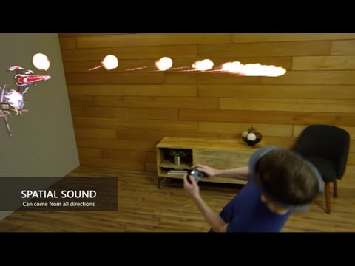
Notes:
Audience overview video for Spatial Sound

Slide 49
Objective
Hear holograms in your world.
Notes:
When objects are out of our line of sight, one of the ways that we can perceive what's going on around us is through sound. On HoloLens, the audio engine provides the aural component of the mixed-reality experience by simulating 3D sound using direction, distance, and environmental simulations. Using spatial sound in an application allows developers to convincingly place sounds in a 3 dimensional space (sphere) all around the user. Those sounds will then seem as if they were coming from real physical objects or the mixed reality holograms in the user's surroundings. Given that holograms are objects made of light and sometimes sound, the sound component helps ground holograms making them more believable and creating a more immersive holographic experience.
Although holograms can only appear visually where the user's gaze is pointing, your app's sound can come from all directions; above, below, behind, to the side, etc. You can use this feature to draw attention to an object that might not currently be in the user's view. A user can perceive sounds to be emanating from a source in the mixed-reality world. For example, as the user gets closer to an object or the object gets closer to them, the volume increases. Similarly, as objects move around a user, or vice versa, spatial sounds give the illusion that sounds are coming directly from the object.

Slide 50
Notes:
This code loads an impact audio clip and then plays that sound if the sphere collides with another object.

Slide 51
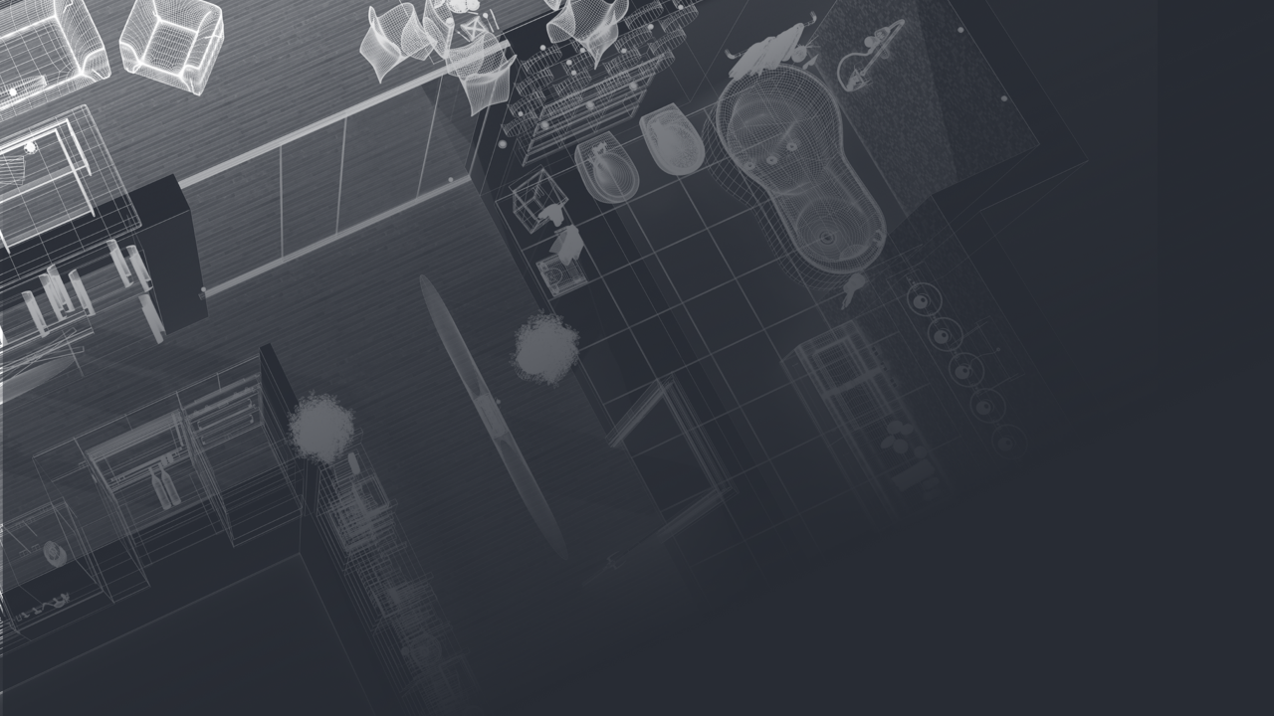
Spatial Mapping
Notes:
Presenter video overview of the Spatial Mapping section:
https://www.youtube.com/watch?v=S-517Y63Cnk

Slide 52
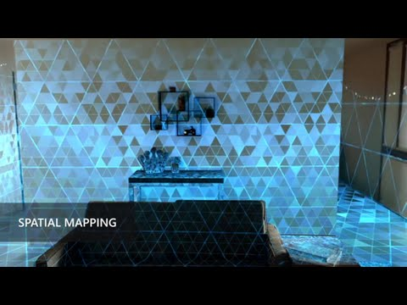
Notes:
Audience overview video of Spatial Mapping

Slide 53
Objective
Bring your real world into the virtual world.
Notes:
Spatial mapping provides a detailed representation of real-world surfaces in the environment around the HoloLens, allowing developers to create a convincing mixed reality experience. By merging the real world with the virtual world, an application can make holograms seem real. Applications can also more naturally align with user expectations by providing familiar real-world behaviors and interactions.

Slide 54
Notes:
This code snippet manipulates the placement of an object using the spatial mapping mesh.

Slide 55
Only the beginning…
Notes:
In our demo we’ve covered the basics of Hololens, but there are so many possibilities that YOU, the developers, are going to make real!

Slide 56
Fibrum SDK
VSR
Oculus SDK
Immerse
Other
Toolkits
Notes:
We’ve shows how to develop a simple Hololens application. Depending on which platform you are targeting, there are a number of other frameworks that may be worth exploring.

Slide 57
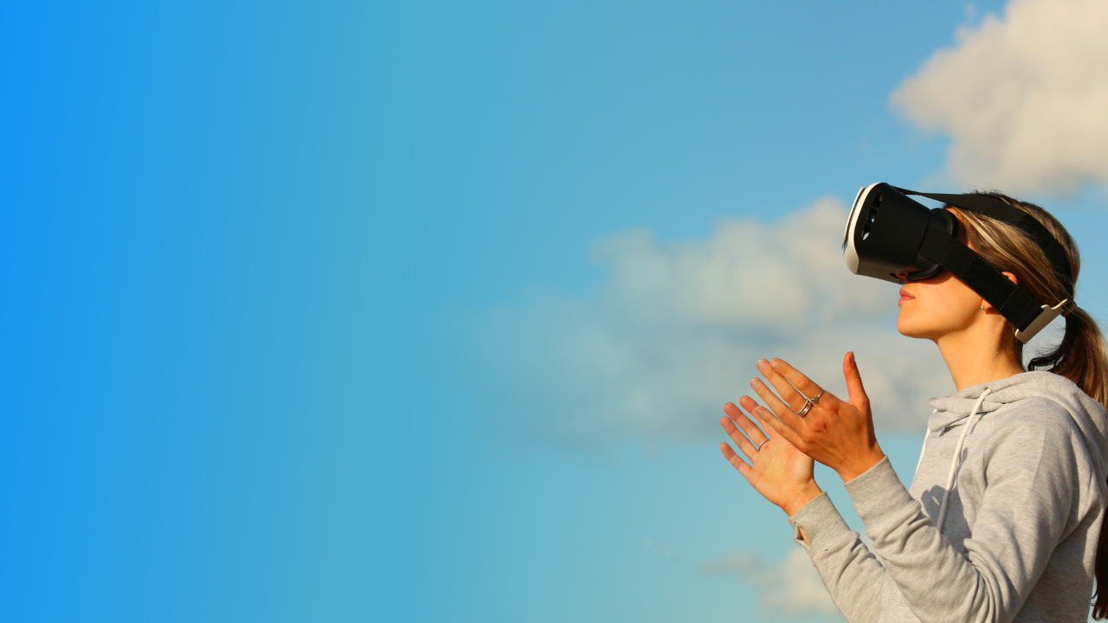
VR+Future
Notes:
Exciting time to get involved
Download SDKs and experiment more.
Easy to get started on a phone you already have
Join a local Microsoft Student Partner chapter
Build your own VR project and enter it in Imagine Cup

Slide 58
Thank you!

Slide 59
Thoughts or
Questions?

